Slide 1
1.6. INDUSTRIAL DUST CONTROL METHODS AND EQUIPMENTS

Slide 2
1.6.1. CONTROL METHODS
1.6.1.1. SOURCE CORRECTION METHODS
Raw material changes (substitution of raw materials): A particular raw material responsible for air pollution is replaced with purer grade raw material. E.g.. Use of low sulphur fuel in place of high sulphur one.
Process changes (Process modification): New or modified techniques are employed which offer important way of minimizing atmospheric pollutant emissions. E.g.. in chemical and petroleum refining industries, volatile substances are recovered by condensation and non-volatile ones are recycled for additional reactions.
Equipment modification or replacement: Suitable modification or replacement of process equipment help reduce the pollution. E.g. unburnt CO and hydrocarbons can be burnt by injecting air into hot exhaust manifold. (Rao, 2006)

Slide 3
1.6.1. CONTROL METHODS
1.6.1.2. CLEANING OF GASEOUS EFFULENTS
1. Particulate Control Equipment: Particulate matters are removed by the use of various equipment. They are:
a. Inertial Separators
> Gravitational Settling Chambers
> Centrifugal Collectors
- Single Cyclone Separator
- Multiple Cyclone Separator
b. Fabric Filters
c. Wet Scrubbers
d. Electrostatic Precipitators (“Dust Collector”, n.d.)
2. Gases and Odour Control Equipments: It utilizes equipment for chemical alteration of the pollutant through combustion, catalytic incineration, adsorption, absorption, etc.

Slide 4
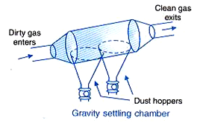
1.6.2. CONTROL EQUIPMENTS
1. GRAVITATIONAL SETTLING CHAMBER
Used to remove large abrasive particles (usually >50 µm).
Particles settle under gravitational force.
Usually used as pre-cleaners prior to passing the gas stream through high efficiency collection devices.
a. Expansion Chamber Type
Velocity of the gas stream is reduced as the gas expands in large chamber.
The reduction in velocity allows larger particles to settle out of the gas stream.

Slide 5
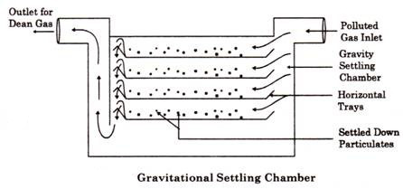
1.6.2. CONTROL EQUIPMENTS
1. GRAVITATIONAL SETTLING CHAMBER
b. Multiple Tray Chamber Type (Howard Settling Chamber)
Contains a number of thin trays closely spaced within the chamber, which causes the gas to flow horizontally between them.
The several horizontal shelves or trays improve the collection efficiency by shortening the settling path of the particles.

Slide 6
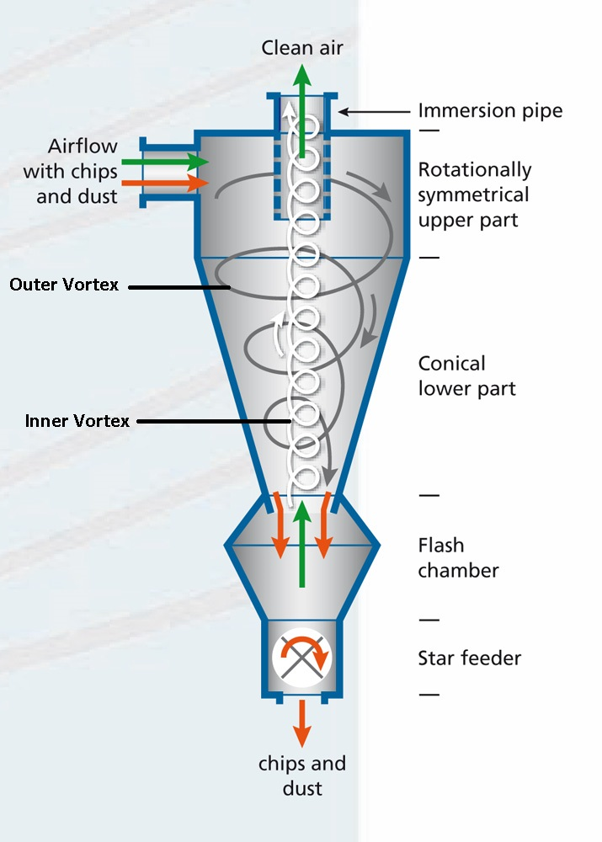
1.6.2. CONTROL EQUIPMENTS
2. CYCLONE SEPARATOR
a. Single Cyclone Separators
They create a dual vortex to separate coarse from fine dust.
The main vortex spirals downward and carries most of the coarser dust particles. The inner vortex, created near the bottom of the cyclone, spirals upward and carries finer dust particles.
Centrifugal force is utilized by them to separate the particulate matter from the polluted gas.

Slide 7
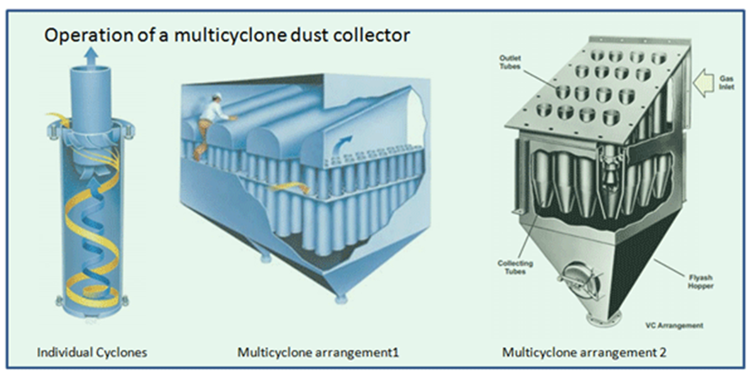
1.6.2. CONTROL EQUIPMENTS
2. CYCLONE SEPARATOR
b. Multiple Cyclone Separators
They consist of a number of small-diameter cyclones, operating in parallel and having a common gas inlet and outlet, as shown in the figure, and operate on the same principle as single cyclone separators—creating an outer downward vortex and an ascending inner vortex.

Slide 8
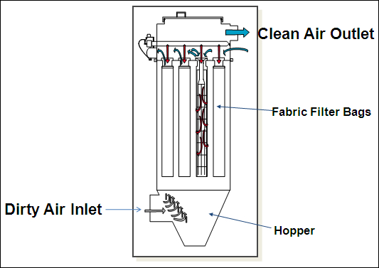
1.6.2. CONTROL EQUIPMENTS
3. FABRIC FILTERS (BAGHOUSE FILTERS)
They use filtration to separate dust particulates from dusty gases. They are one of the most efficient and cost effective types of dust collectors available and can achieve a collection efficiency of more than 99% for very fine particulates.
Dust-laden gases enter the baghouse and pass through fabric bags that act as filters. The bags can be of woven or felted cotton, synthetic, or glass-fiber material in either a tube or envelope shape.
The particulate matter is left in the form of a thin dust mat on the insides of the bag. This dust mat further acts as a filtering medium.
The efficiency of the filter gag to sieve particles of 0.5 µm. Filter bags must be cleaned occasionally by a mechanical shaker

Slide 9
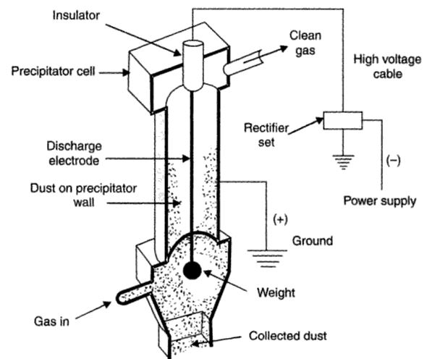
1.6.2. CONTROL EQUIPMENTS
4. ELECTROSTATIC PRECIPITATOR
A number of high-voltage, direct-current discharge electrodes are placed between grounded (positively charged) collecting electrodes.
The negative ions migrate towards the grounded surface and pass on their negative charge to the dust particles also. Then these negatively charged dust particles are electrostatically drawn towards the positively charged collector surface, where they finally get deposited.
The collecting surface is vibrated periodically to remove the collected dust particles.

Slide 10
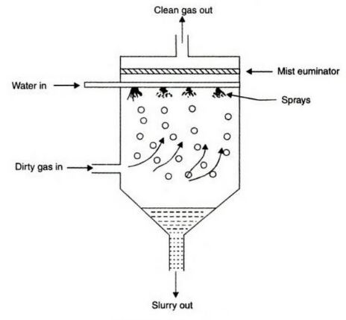
1.6.2. CONTROL EQUIPMENTS
5. WET SCRUBBERS
a. Spray Tower
Water is introduced into a spray tower by means of a spray nozzle.
As the polluted gas flows upwards the particulates (>10 µm) present collide with the water droplets being sprayed downward from the spray nozzles.
Under the influence of gravitational force, the liquid droplets containing the particulates settle to the bottom of the spray tower.

Slide 11
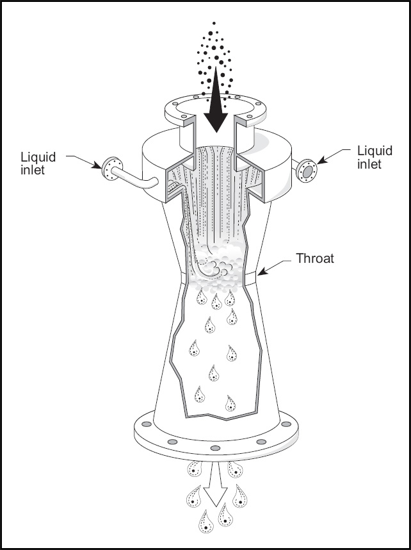
1.6.2. CONTROL EQUIPMENTS
5. WET SCRUBBERS
b. Venturi Scrubber
It removes the particulates of size 0.5 to 5 µm associated with smoke and fumes very efficiently.
Polluted gas speed passing through venturi = 60 –180 m/s.
A coarse water stream is injected upwards into the throat.
The particles collided with liquid droplets get entrained in the droplets and fall down to be removed later on.
To separate the droplets carrying the particulate matter from the gas stream, this gas-liquid mixture is then directed into a separation device such as a cyclone separator.

Slide 12
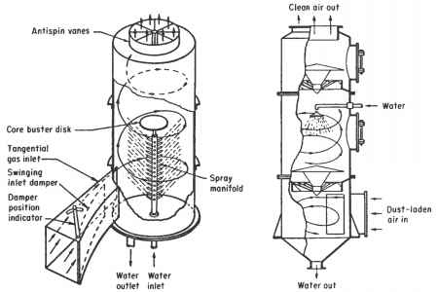
1.6.2. CONTROL EQUIPMENTS
5. WET SCRUBBERS
c. Cyclone Scrubber
High pressure nozzles generate a fine spray that intercepts the small particles in the polluted gas.
The centrifugal force throws these particles towards the wall from where they are drained downwards to the bottom of the scrubber.

Slide 13
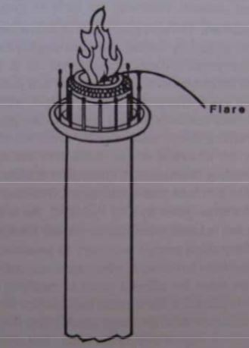
1.6.2. CONTROL EQUIPMENTS
CONTROL OF GAS PHASE EMISSIONS
1. INCINERATION
It is applied to effluent streams containing combustible gases in which the volume flow rate of gas is large and the concentration of the combustible contaminant is relatively low.
a. Direct Flame Incineration
Flare incinerator is a direct flame type system used in petrochemical plants and refineries.
It is used for combustible waste gases that cannot be conveniently treated any other way.

Slide 14
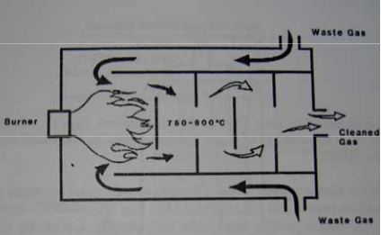
1.6.2. CONTROL EQUIPMENTS
CONTROL OF GAS PHASE EMISSIONS
b. Thermal Incineration
Efficient thermal incineration requires the provision of supplemental fuel to bring the reaction chamber temperature to 750 to 800°C.
It is used to treat effluent streams from a number of industrial processes including varnish cooking, paint bake ovens, meat smoke houses, fat rendering plants, paint application and resin manufacturing.

Slide 15
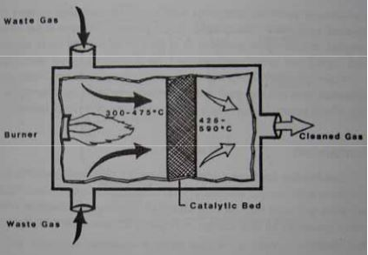
1.6.2. CONTROL EQUIPMENTS
c. Catalytic Incineration
The preheated gases (300-475C) are discharged to a catalytic bed, where combustion occurs.
As effluent gases enter the catalytic bed, they are adsorbed on the surface of the catalyst, increasing the concentration of reacting substances.
Combustion efficiency: 95-98%
It is smaller than thermal incinerator and has less retention time (20-50 times).

Slide 16
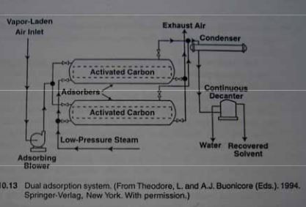
1.6.2. CONTROL EQUIPMENTS
2. ADSORPTION
A variety of contaminant gases can be removed from waste gas streams by being passed through beds or media containing solid sorbents.
Gases coming into contact with solid sorbents may bond to sorbent surfaces (physical adsorption) or may react with sorbent surface (chemisorption).

Slide 17
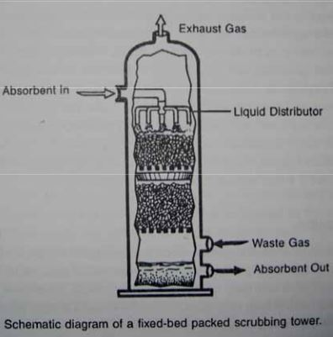
1.6.2. CONTROL EQUIPMENTS
3. ABSORPTION
Gaseous pollutants are absorbed when they come into contact with a medium in which they are soluble or with which they can chemically react.
After the medium is removed from the scrubbing system, absorbed materials must be treated and disposed. For acidic gases waste scrubbing liquids may require neutralization. Solids removal may require the use of settling ponds. Solids generally must be landfilled.

Slide 18
REFERENCES
Rao, C.S. (2006). Environmental Pollution Control Engineering. New Delhi: New Age International (P) Ltd.
Dust Collector. (n.d.). In Wikipedia. Retrieved December 13, 2016, from https://en.wikipedia.org/wiki/Dust_collector# Types_of_dust_collectors
Ale, B. B. (2008). Presentation on Air Pollution Control Methods and Equipment

